Slide 1

Module 1 Basics of Statics
Winter 21-22
School of Mechanical Engineering
BMEE201L Engineering Mechanics
By
Dr. S.JEYANTHI,
SMEC,9840477440
Jeyanthi.subramanian@vit.ac.in
Cabin no-SOM LAB-AB1 006

Slide 2
MODULE 1
Module:1 Statics of Particles
Fundamental concepts and principles - Resolution of a force -Resultant of forces in a plane-Equilibrium of a particle in a plane; Addition of concurrent forces in space- Equilibrium of a particle in space.

Slide 3
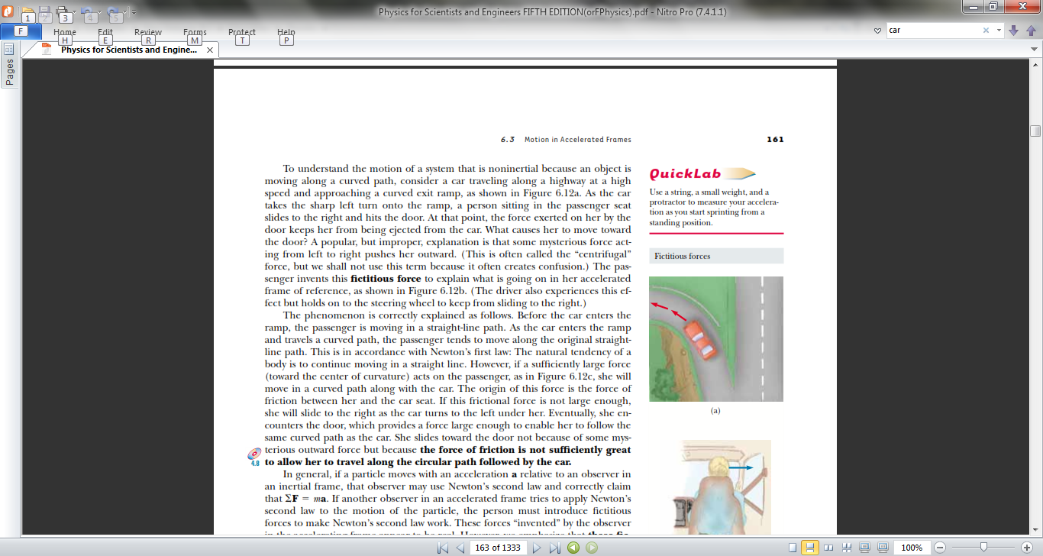
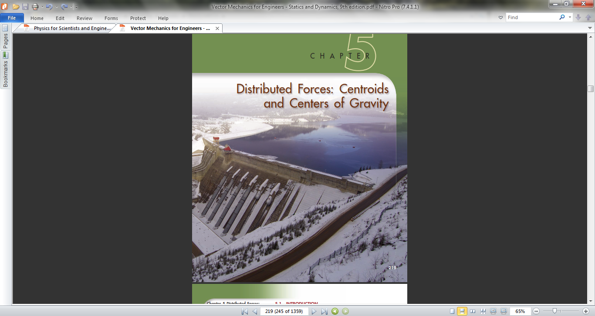
Why engineering mechanics?
You have to design a car, which can run at a speed of 80 km/hr. In order to do this, you have to find engine power and the forces acting on the car body.
To design a dam structure, you need to compute of deflections and internal forces within structures

Slide 4
What is engineering mechanics?
It is a branch of science which deals with the behavior of body at rest or in motion under the action of forces.
Mechanics
Mechanics of
Rigid bodies
Mechanics of Fluids
Mechanics of
Deformable bodies
Statics:
Bodies at rest (Equilibrium of bodies i.e. no motion) under action of Forces.
Statics
Dynamics
Kinetics
Kinematics
Dynamics: Motion of bodies
- without considering force
- considering force

Slide 5
Outline
Forces in plane
Resultant
Two forces -parallelogram and triangular law
Resultant of several forces - polygon law and rectangular components
Equilibrium of a particle
Free body diagram
Lami’s theorem
Rectangular components
Forces in space
Rectangular components
Resultant
Equilibrium of a particle

Slide 6
Keywords
Particle
Rigid Body
Force
Resultant
Newton’s Laws
Paralellogram Law
Lami’s Theorem
Principle of Transmissibility
Moment
Couple
Equilibrium

Slide 7


What do they do?

Slide 8

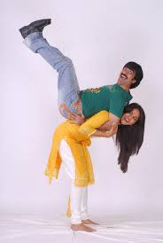

How do they feel ?

Slide 9
Force
A physical quantity
brought into equilibrium
gravity

Slide 10
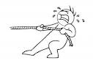

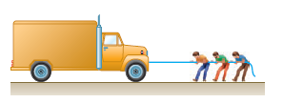
Representation
Magnitude
Direction
Point of application
Line of action

Slide 11


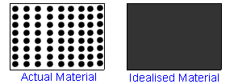

Particle? Rigid body? Deformable body?
Particle: Body of negligible dimensions
Rigid body: Body with negligible deformations
Non-rigid body: Body which can deform
Continuum: Body is assumed to consist of continuous distribution of matter
In Statics, bodies are considered rigid unless stated otherwise.

Slide 12
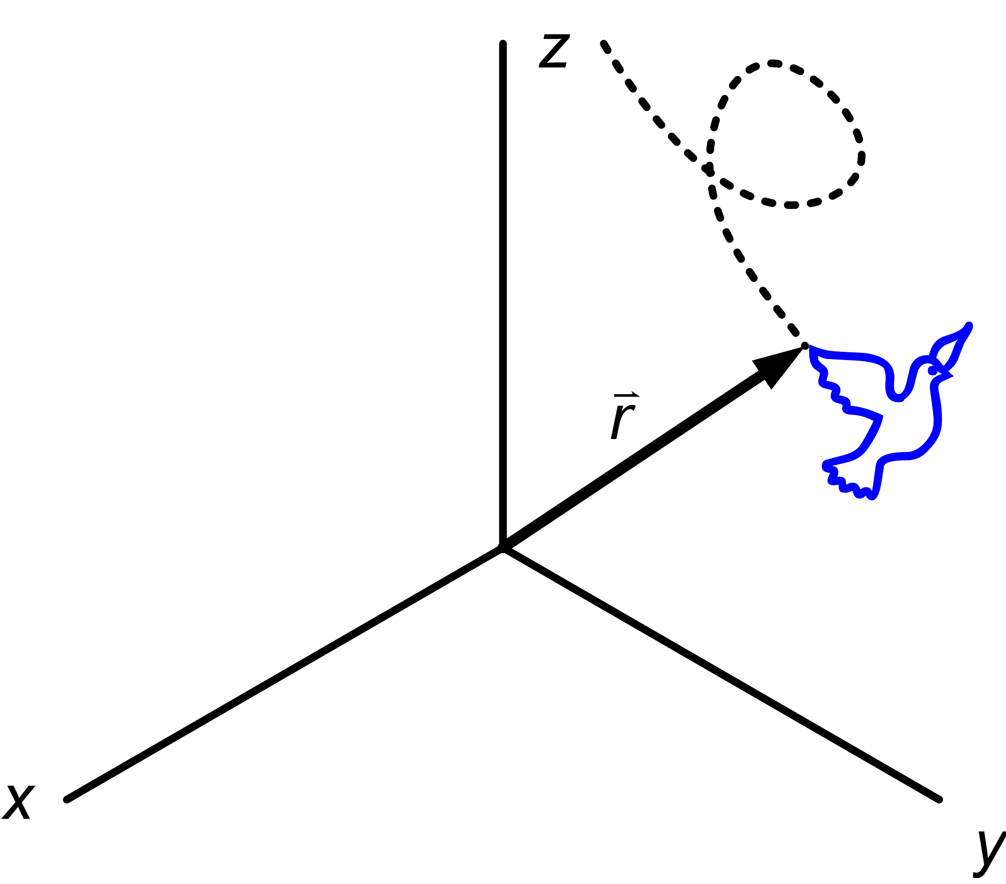
Basic Concept - Definition
position,
velocity,
acceleration
Space: Collection of points whose relative positions
can be described using “a coordinate system”
Time : For relative occurrence of events
Mass : - A measure of how much matter is in an object.
For example, a gold bar is quite small but has a mass of 1 kilogram, so it contains a lot of matter.
- It is a measure of the inertia of a body, which is its resistance to a change of velocity.

Slide 13
Types of UNIT
FPS – Foot pound second
CGS – Centimetre Gram Second
MKS – Metre Kilogram Second
SI – System International

Slide 14
Basic Concept - Force
Force : Vector quantity that describes an action of
one body on another.
The SI unit of force magnitude is the newton (N) or kg·m/s² or kg·m · s ^{– 2}
Resultant of a force system is a single force which produces the same effect as that of the force system. It is the equivalent force all the given forces.
Resolution of a force is the process of splitting up the given force into number of components.

Slide 15
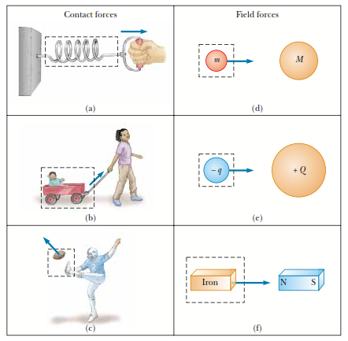
Force - Examples

Slide 16
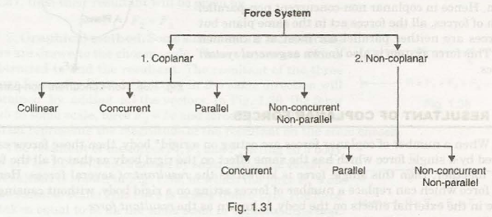
Force System
A group of forces acting together on a body
Classification:

Slide 17
Classification
Collinear
Concurrent
Parallel
Non-concurrent non-parallel

Slide 18

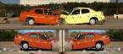
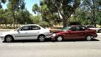
Collinear Forces

Slide 19
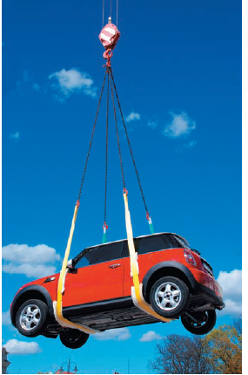
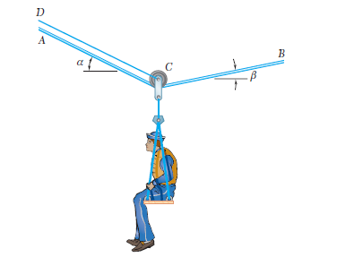
Concurrent Forces
In Plane (2D)
In Space (3D)

Slide 20
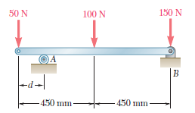
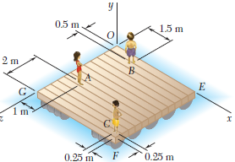
Parallel Forces
In Plane (2D)
In Space (3D)

Slide 21
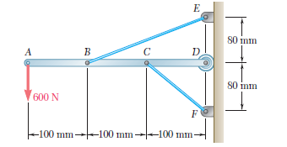
Non-parallel and non-concurrent

Slide 22
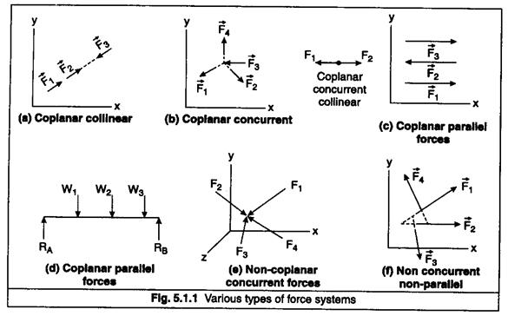
Type of Force System

Slide 23
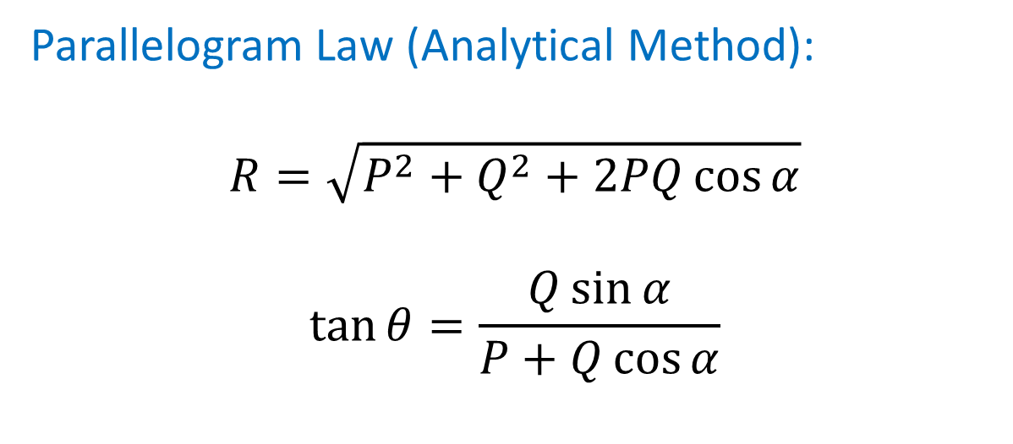
Forces in Plane-Resultant
Parallelogram law
Triangular law
Polygon law
Rectangular components
Q
R
α
θ
P

Slide 24
Resultant Force Finding Methods
Analytical Method
Trignometric Method (Parallelogram formula, Lami’s theorem)
Resolution Method
Graphical Method
Triangle Law of Forces
Polygon Law of Forces

Slide 25
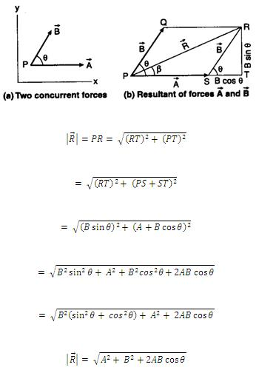
THE PARALLELOGRAM LAW

Slide 26
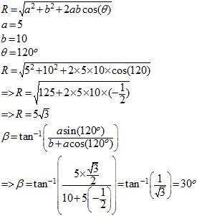
Parallelogram Law - Problem

Slide 27
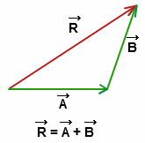
Derived Laws
Triangle Law of Forces
If two forces acting on a body are represented by the sides of a triangle, their resultant is represented by the closing side of the triangle taken from first point to the last point.

Slide 28
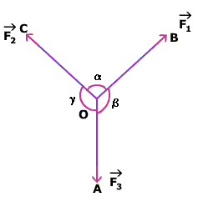
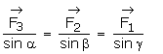
Derived Laws
Lami’s Theorem
If three forces acting at a point are in equilibrium, each force is proportional to the sine of the angle between the other two forces.

Slide 29
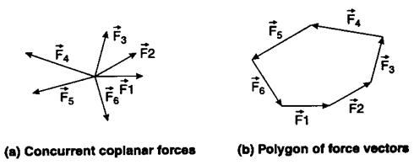
Derived Laws
Polygon Law of Forces
If a number of concurrent forces acting simultaneously on a body are represented in magnitude and direction by the sides of a polygon, taken in order, then the resultant is represented in magnitude and direction by the closing side of the polygon.

Slide 30
Derived Laws
Polygon Law of Forces
If a number of concurrent forces acting simultaneously on a body are represented in magnitude and direction by the sides of a polygon, taken in order, then the resultant is represented in magnitude and direction by the closing side of the polygon.

Slide 31
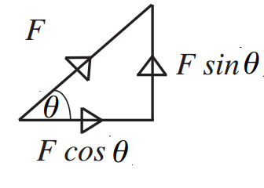
Resolution of forces
Forces acting at some angle from the coordinate axes can be resolved into mutually perpendicular forces called components.
The component of a force parallel to the x-axis is called the x-component, parallel to y-axis the y-component, and so on.

Slide 32
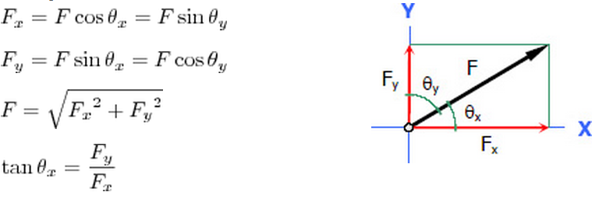
Resolution of forces
Components of a Force in XY Plane

Slide 33
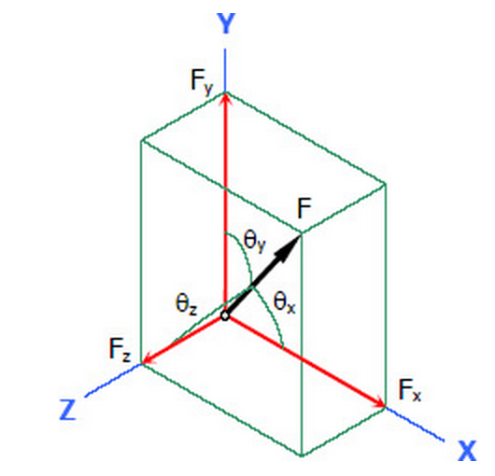
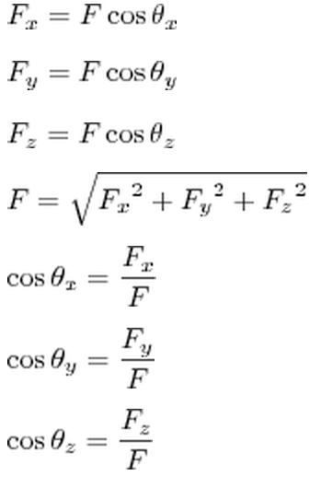
Resolution of forces
Components of a Force in 3D Space

Slide 34
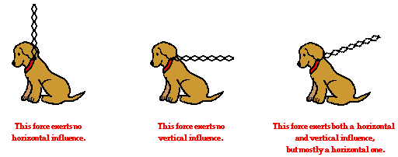
Resolution of forces
To find a resultant of number of forces,
Determine horizontal and vertical components of all forces.
Add horizontal forces (F_{horiz} or F_{x} = F cos θ ).
Similarly, add Vertical Forces (F_{vert} or F_{y} = F sin θ ).
Find Magnitude and direction of the resultant force

Slide 35
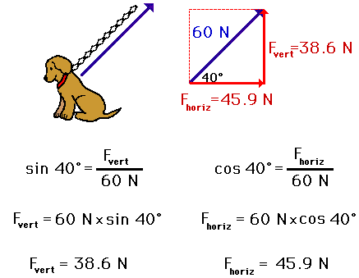
Resolution of forces – Single Force Example

Slide 36
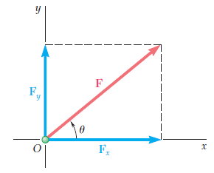
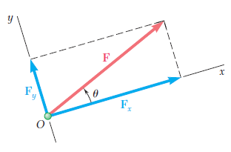
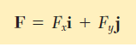
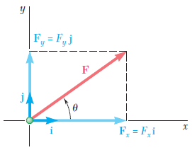
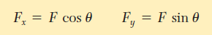
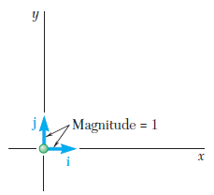
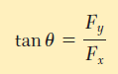
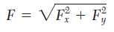
Rectangular Components of a Force

Slide 37
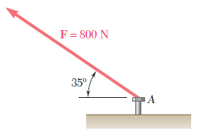
Example 1
A force of 800 N is exerted on a bolt A as shown in Figure. Determine the horizontal and vertical components of the force.

Slide 39
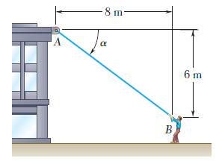
Example 2
A man pulls with a force of 300 N on a rope attached to a building, as shown in Figure. What are the horizontal and vertical components of the force exerted by the rope at point A ?

Slide 40
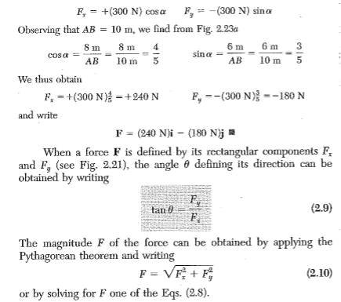
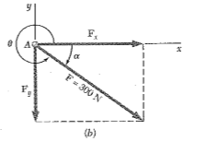

Slide 41
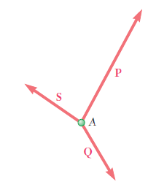
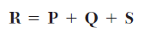
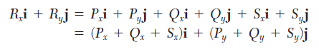
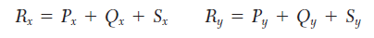
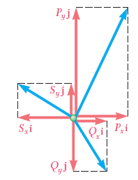
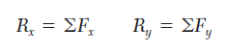
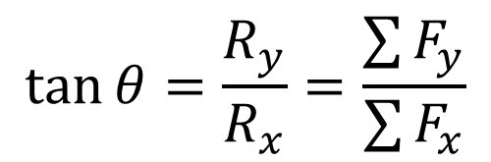
Resultant of Several Concurrent Forces

Slide 42
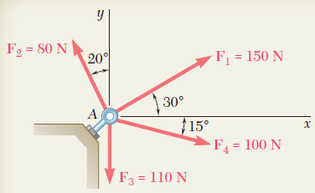
Class Problem 3

Slide 43

First resolved all the forces in vertical and horizontal directions;
Let ∑H = Sum of Horizontal components
∑V = Sum of Vertical components
∑H = 150 cos 30° + 80 cos 110° + 110 cos 270° + 100 cos 345° = 199.13N..........(i)
∑V = 150 sin 30° + 80 sin 110° + 110 sin 270° + 100 sin 345° = 14.29N

Slide 44
R = (∑H2 + ∑V2)1/2 = {(199.13)2 + (14.29)2}1/2
R = 199.6N
Let angle made by resultant is θ
tanθ = ∑V/∑H = 14.29/199.13 = 4.11º

Slide 45

Class Problem 1
The two forces P and Q act on a bolt A. Determine their resultant.

Slide 46


Solution
Graphical solution
A parallelogram with sides equal to P and Q is drawn to scale.
The magnitude and direction of the resultant or of the diagonal to the parallelogram are measured,
A triangle is drawn with P and Q head-to-tail and to scale.
The magnitude and direction of the resultant or of the third side of the triangle are measured,

Slide 47

Trigonometric solution
Apply the triangle rule, From the Law of Cosines,
From the Law of Sines,

Slide 48

Determine the resultant of the three forces of Problem

Slide 49


Slide 50


Slide 51

Determine the x and y components and ,resultant

Slide 52


Slide 53


Slide 54


Free Body Diagram
Free body diagram is a sketch of the isolated body, which shows the external forces on the body and the reactions exerted on it by the removed elements.
Procedure:
Isolate each body from the system
Indicate all the forces acting on it including the weight
Indicate all reactions
Show the dimensions and angles and reference axes

Slide 55



Free Body Diagram-Cable and Spring

Slide 56





Draw Free Body Diagram

Slide 57




Equilibrium of a Particle
The particle is in equilibrium when R=ΣF=0
Lami’s Theorem:
If three concurrent forces are acting on a body, kept in an equilibrium, then each force is proportional to the sine of the angles between the other two forces and the constant of proportionality is the same.

Slide 58


Slide 59


Slide 60


Slide 61

Class Problem 4
In a ship-unloading operation, a 3500 N automobile is supported by a cable. A rope is tied to the cable at A and pulled in order to centre the automobile over its intended position. The angle between the cable and the vertical is 2°, while the angle between the rope and the horizontal is 30°. What is the tension in the rope?

Slide 62


Solution
Construct a free-body diagram for the particle at A.
Apply the conditions for equilibrium.

Slide 63

Tutorial Problem 2
F = 76.1 N
α = 15°
Determine the magnitude and direction of the smallest force F which will maintain the package shown in equilibrium. Note that the force exerted by the rollers on the package is perpendicular to the incline.

Slide 64





Solution
$$\frac{294}{\sin{θ}}=\frac{F}{\sin{15}}$$
$$F=\frac{294\sin{15}}{\sin{θ}}$$
For minimum F, θ is 90°

Slide 65


Slide 66



Slide 67



Slide 68


Slide 69


Slide 70

Tutorial Problem 3
A 160-kg load is supported by the rope-and-pulley arrangement shown. Knowing that β = 20°, determine the magnitude and direction of the force P that must be exerted on the free end of the rope to maintain equilibrium.
P = 602 N
α = 46.8°

Slide 71

Tutorial Problem 4
Two forces P and Q are applied as shown to an aircraft connection. Knowing that the connection is in equilibrium and that P = 500 N and Q = 650 N, determine the magnitudes of the forces exerted on the rods A and B.

Slide 72






Rectangular component of a Force in Space

Slide 73







Slide 74






Slide 75







Force Defined by its Magnitude and Two Points on its Line of Action

Slide 76




ADDITION OF CONCURRENT FORCES IN SPACE

Slide 77

Class Problem 4
Fx = -1060 N; Fy = 2120 N; Fz = 795 N
A tower guy wire is anchored by means of a bolt at A. The tension in the wire is 2500 N. Determine
the components F_{x}, F_{y}, F_{z} of the force acting on the bolt,
the angles θ_{x}, θ_{y}, θ_{z} defining the direction of the force.

Slide 78


Slide 79


Slide 80


Slide 81

Tutorial Problem 5
Knowing that the tension in cable AB is 1425 N, determine the components of the force exerted on the plate at B.
-1125 N, 750 N, 450 N

Slide 82


Slide 83

Tutorial Problem 6
Find the magnitude and direction of the resultant of the two forces shown knowing that P = 300 N and Q = 400 N.

Slide 84


Slide 85


Equilibrium of a Particle in Space
Class Problem 5
A 200-kg cylinder is hung by means of two cables AB and AC, which are attached to the top of a vertical wall. A horizontal force P perpendicular to the wall holds the cylinder in the position shown. Determine the magnitude of P and the tension in each cable.
P = 235 N
T_{AB} = 1402 N
T_{AC} = 1238 N

Slide 86

Tutorial Problem 7
Three cables are used to tether a balloon as shown.
Determine the vertical force P exerted by the balloon at A knowing that the tension in cable AB is 259 N.
Determine the vertical force P exerted by the balloon at A knowing that the tension in cable AD is 481 N.
P = 1031 N
P = 926 N

Slide 87


